Slide 1



M.E.S.ABASAHEB GARWARE COLLEGE,PUNE
Efficacy of Lungs: A Statistical Study
2019-2020
T.Y. B.Sc. Project Competition
T.C. College, Baramati
Submitted by : Rujuta Kulkarni, Madhura Pote, Janaki Inamdar, Aparna Patil, Jyoti Wagh

Slide 2
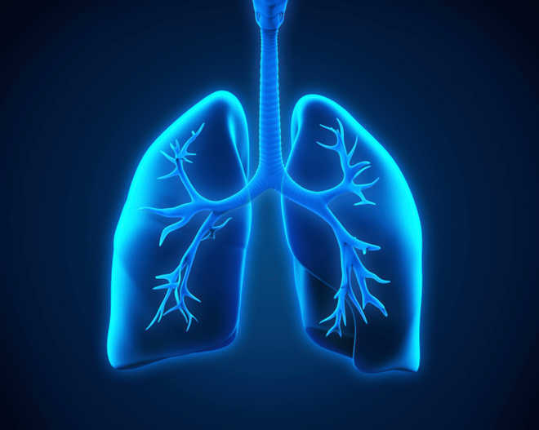
INTRODUCTION
Lung capacity or total lung capacity is the volume of air in the lungs upon the maximum effort of inspiration.
The average lung capacity for male is 6 litre and for female it is 4.2 litre. (Standard values).
TLC = RV + ERV + IRV+ TV
Where RV is residual volume, ERV is expiratory reserve volume, IRV is inspiratory reserve volume, TV is tidal volume.
Total sample size of the data : 310
Number of males : 158
Number of females : 152

Slide 3

ABSTARCT
We observe that different people have different stamina of doing exercise like to climb the hill, walking , running etc.
and the reason behind it is different lung capacities of different people.
This project throws light on the estimation of lung capacity of an individual depending upon various factors like age, height, weight, profession, smoking etc.
Methods to estimate the lung capacity are :
Incentive Spirometer
Balloon method
Water Spirometer
KEYWORDS: Box-Cox method, Kolmogorov-Smirnov test, Kruskal-Wallis test, Mann Whitney test, Multiple linear Regression , Shapiro-Wilk test, Weighted Least Square.

Slide 4
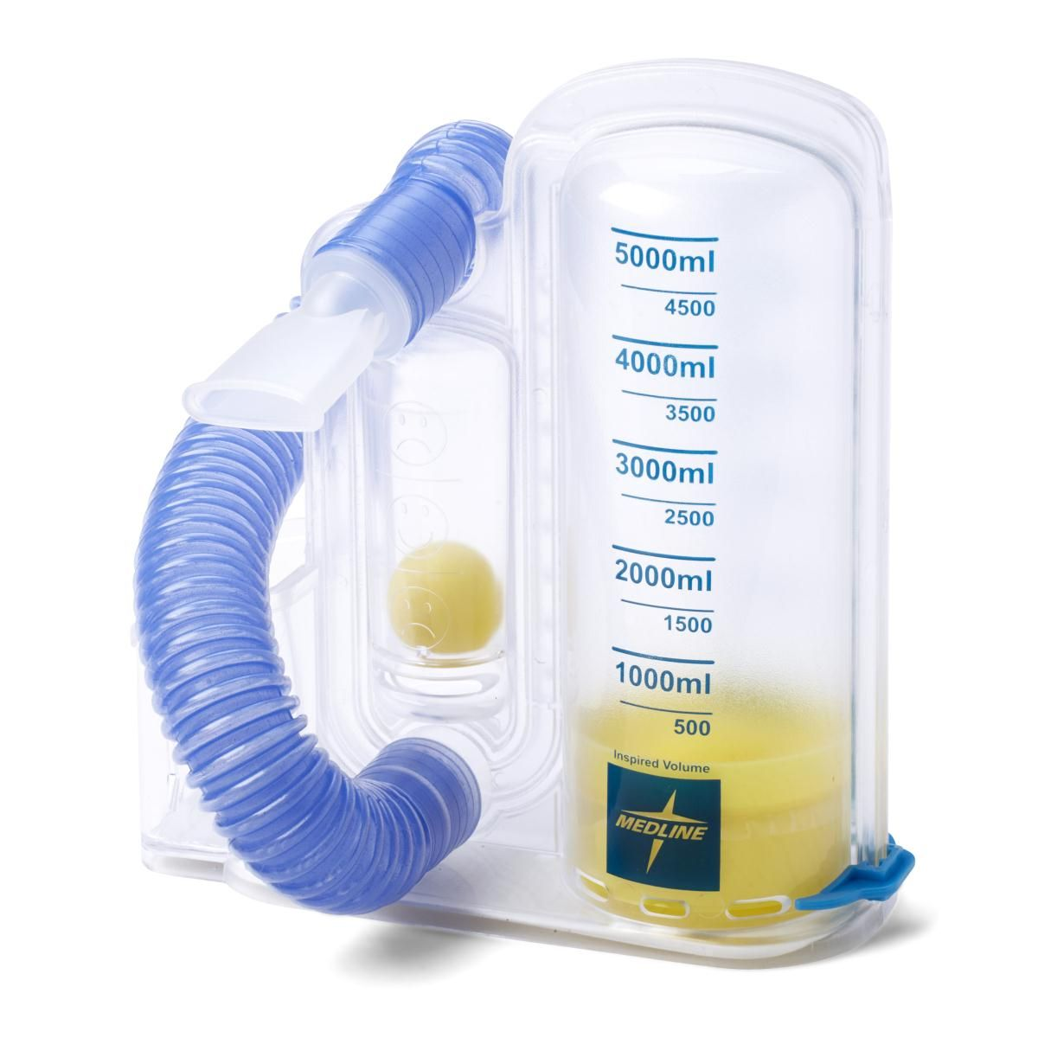
Measurement techniques of Lung Capacity
MECHANICAL SPIROMETER
Generally it is called as Incentive spirometer.
It is widely used in hospitals and as well as doctors suggest it to use at home.
It is costly as compared to others.
The method to estimate lung capacity is exactly opposite to the water spirometer.

Slide 5
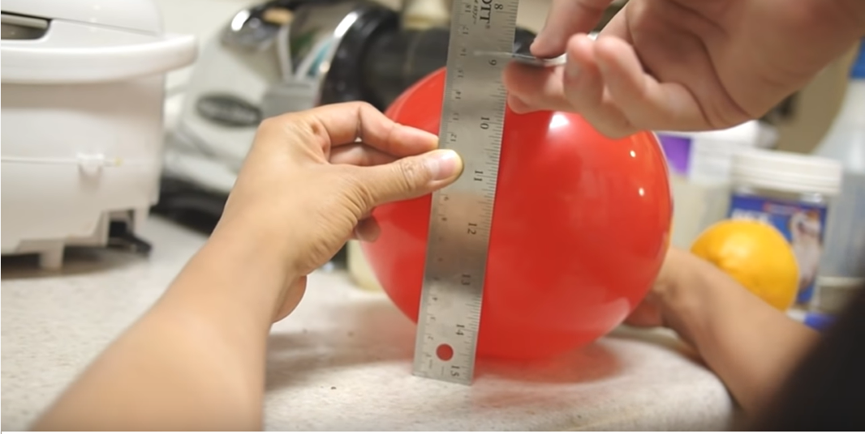
BALLOON METHOD
In this method an individual is allow to blow balloon in only one breath.
Circumference is measured using measuring tape or scale as shown in fig above. Using formula of volume of sphere we can estimate the lung capacity of an individual.
But the drawback is that for every balloon the elasticity of rubber will not be same and most of the folks were not able to blow the balloon which can affect on the actual value of lung capacity.

Slide 6
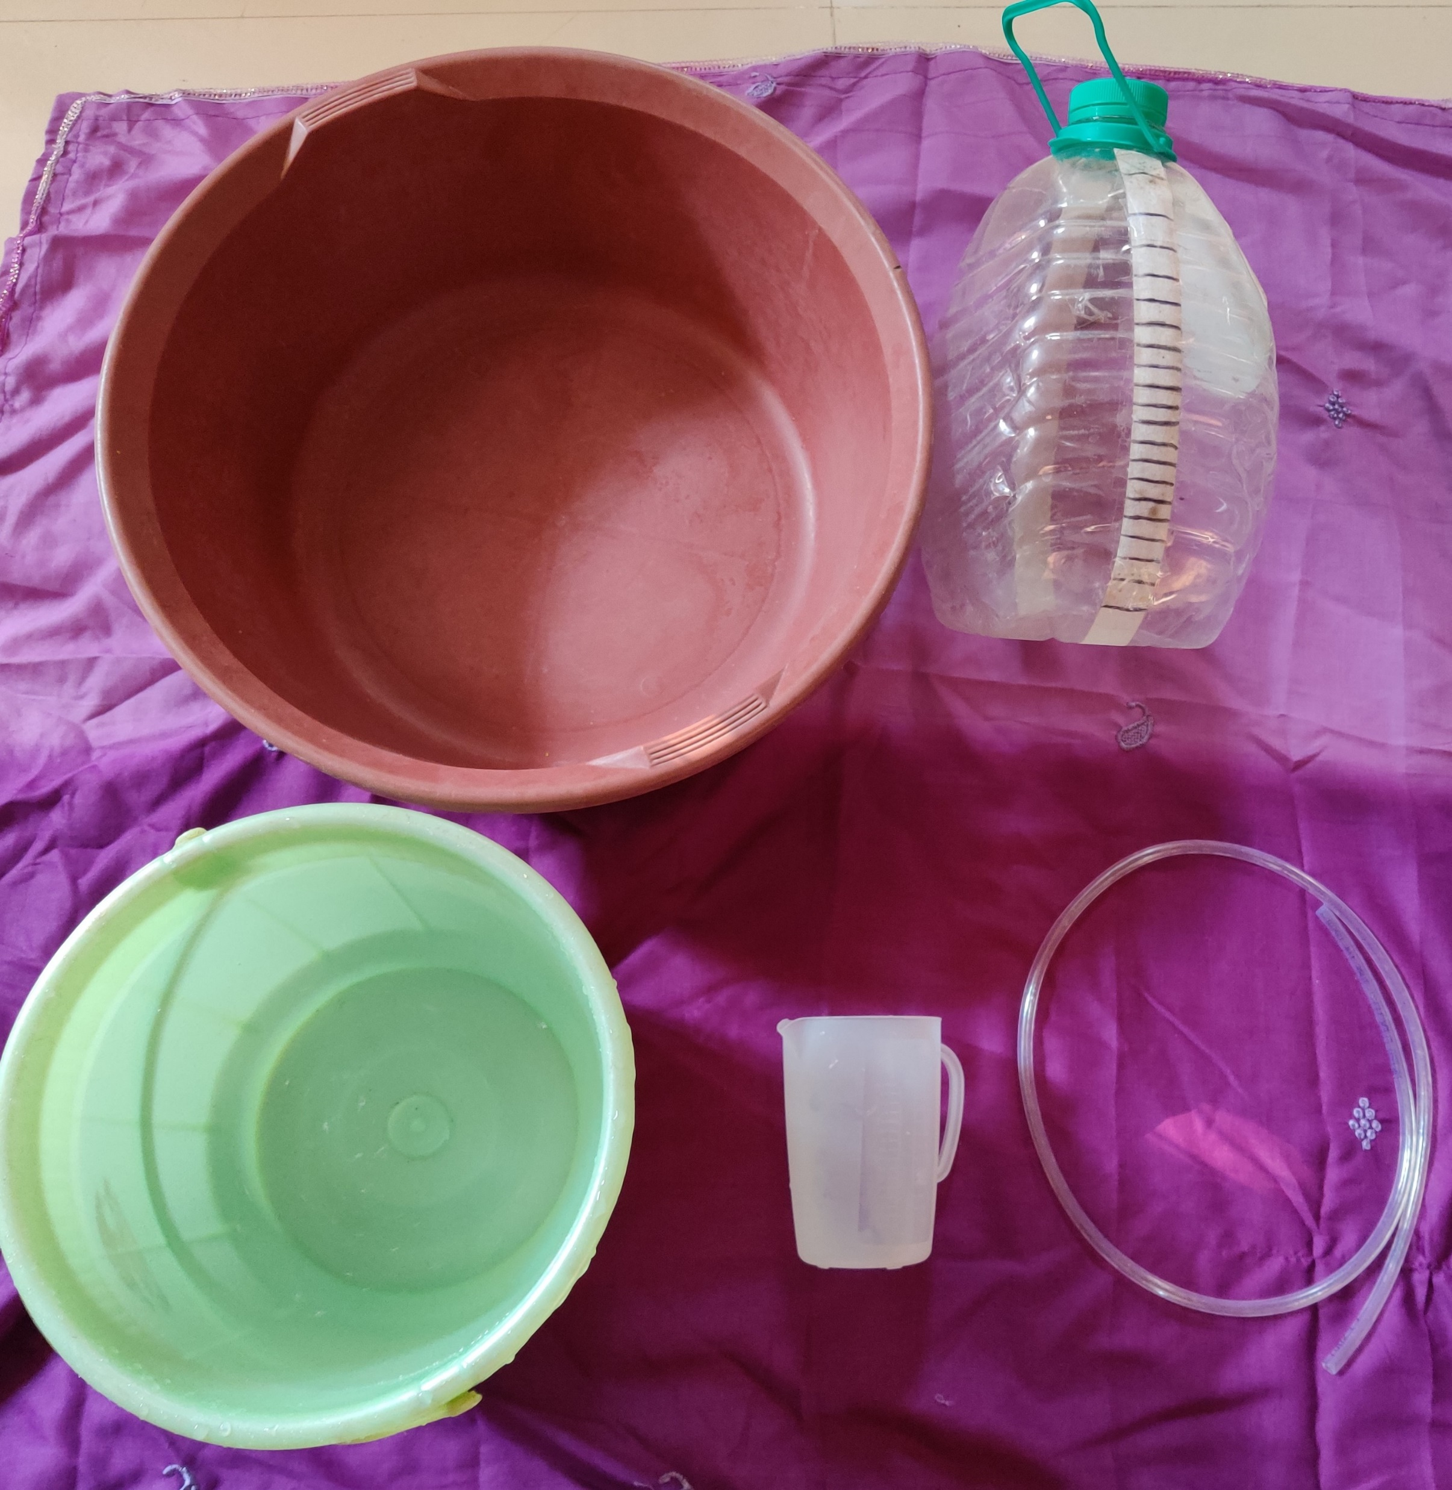
WATER SPIROMETER
It is very simple method and estimates lung capacity of an individual with 95% of accuracy.
The requirements for making the water spirometer are easily available and it is the cheapest method among all.

Slide 7
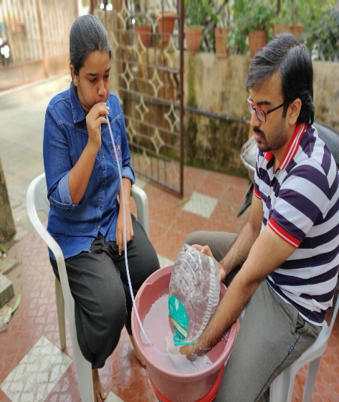
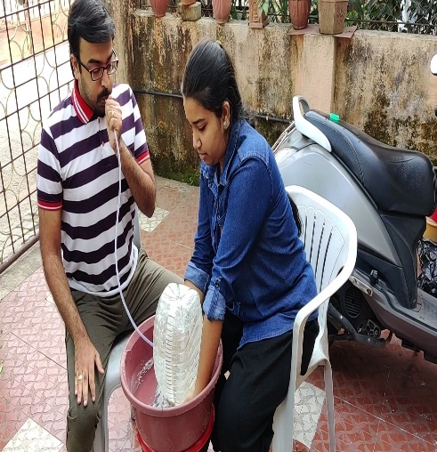
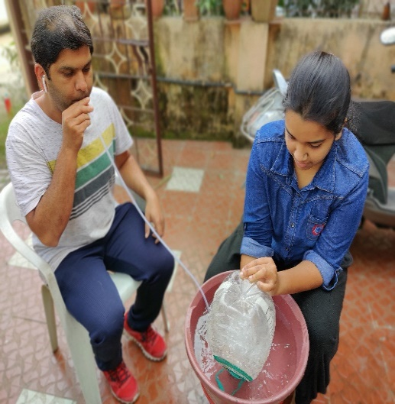
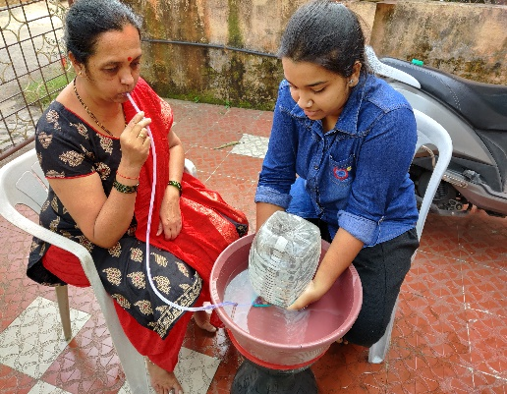
Data collection method :
GENDER: FEMALE
AGE:20
HEIGHT:1.6764
LUNG CAPACITY: 4.2L
GENDER: MALE
AGE: 28
HEIGHT:1.76784 metre
LUNG CAPACITY: 4.5L
GENDER: MALE
AGE:33
HEIGHT:1.70688 metre
LUNG CAPACITY: 3.5L
Gender: FEMALE
AGE: 53 years
HEIGHT: 1.64592 metre
LUNG CAPACITY: 2.2L

Slide 8

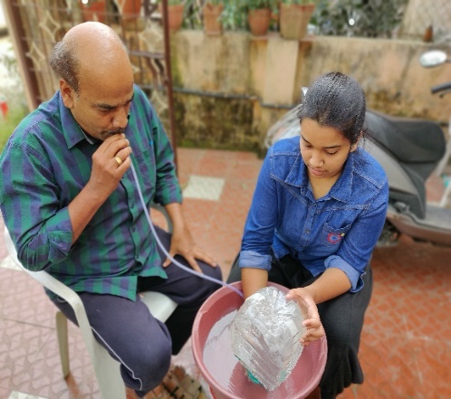
GENDER: FEMALE
AGE: 27
HEIGHT:1.64592 metre
LUNG CAPACITY: 3.3L
GENDER: MALE
AGE: 58
HEIGHT:1.81 metre
LUNG CAPACITY: 3.2L
Heart surgery : Paacemaker

Slide 9
SMOKING
PULSE RATE
AGE
PROFESSION
LUNG CAPACITY DEPENDS ON
HEIGHT
WEIGHT

Slide 10
Exploratory Data Analysis

Slide 13
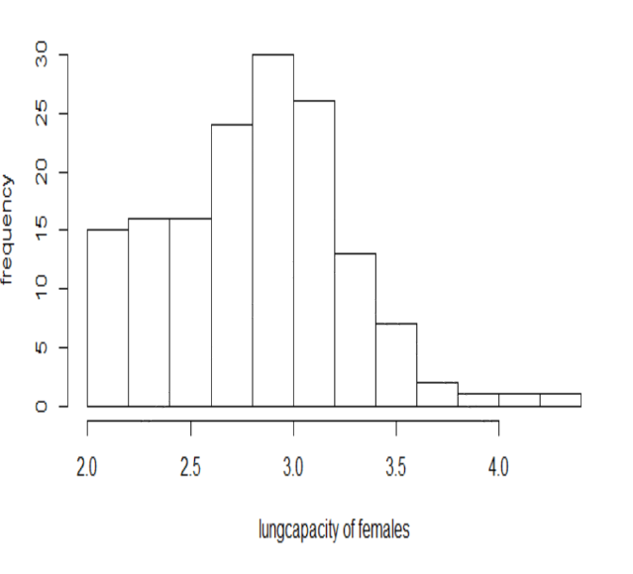
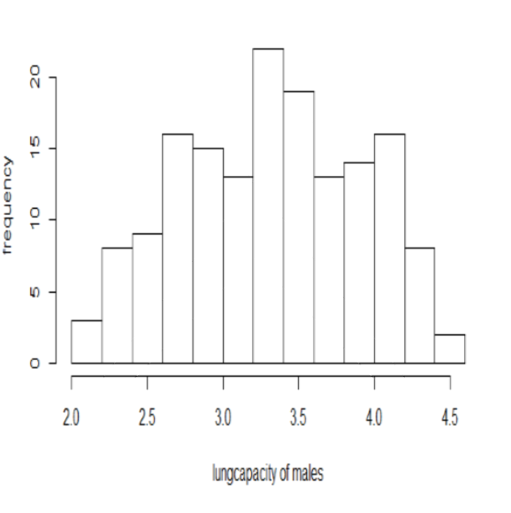
Histogram of Lung Capacity with respect to Gender
Negatively Skewed for males
Positively Skewed for females

Slide 14
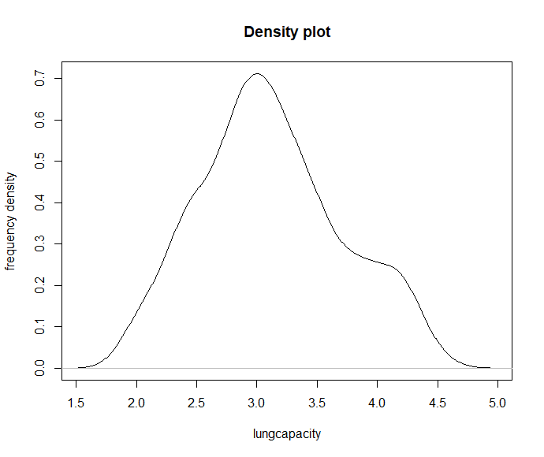
Distribution of Lung Capacity
Shapiro wilk test:
W=0.97741
P value: 0.01326
Lung capacity is not normally distributed at 0.05 level of significance.

Slide 15
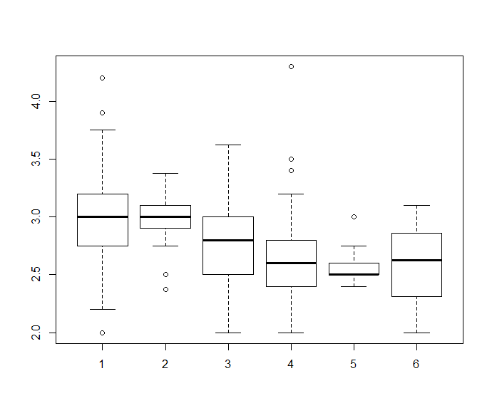
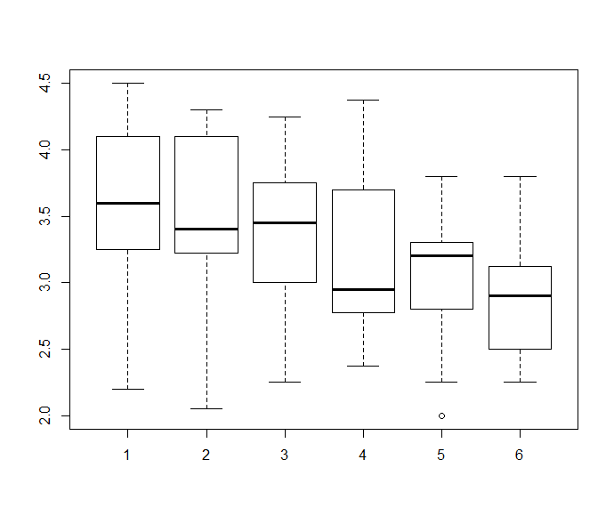
Boxplot For Lung Capacity with respect to age
For Females
For Males

Slide 16
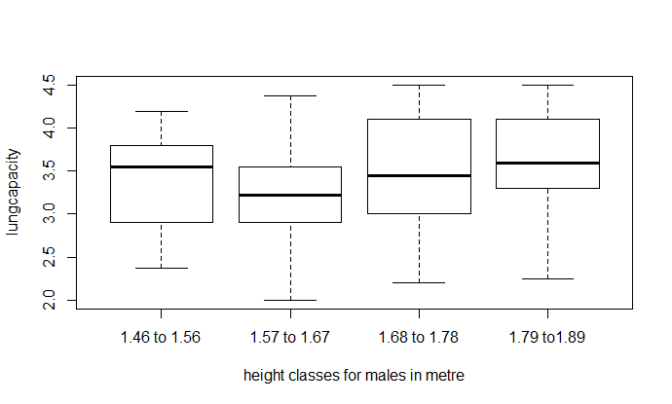
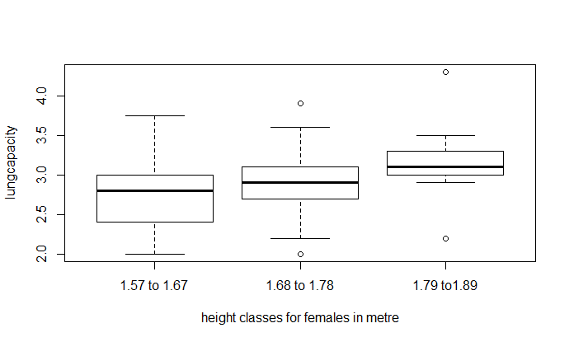
Boxplot For Lung Capacity with respect to height
For Males
For Females

Slide 17
STATISTICAL
ANALYSIS

Slide 18
Descriptive Statistics for Lung Capacity (in Litre)
MALE
MEAN: 3.3698
VARIANCE: 0.3557
SKEWNESS:
-0.1571
KURTOSIS:
-0.8253
FEMALE
MEAN: 2.8530
VARIANCE:
0.1946
SKEWNESS: 0.1945
KURTOSIS:
0.3909
TOTAL
MEAN: 3.1164
VARIANCE: 0.3428
SKEWNESS: 0.2653
KURTOSIS:
-0.5319
Male average lung capacity is greater than the female average lung capacity.

Slide 19
t test for Correlation
LUNG CAPACITY |  | Age | Height | Weight
 | Correlation coefficient | -0.2499 | 0.4005 | 0.2353
 | t statistic | 4.5294 | 7.6719 | 4.2484
 | Df | 308 | 308 | 308
 | P value | 4.234e-06 | 1.124e-13 | 1.428e-05
age is negatively correlated with lung capacity.
Age, height, weight are linearly related with lung capacity.
Height is positively correlated with lung capacity
Weight is positively correlated with lung capacity

Slide 20
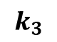
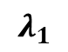
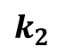
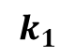
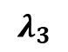
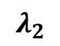
TO CHECK MULTICOLLINEARITY :
Age
1.498801
Height
1.369488
$$λ_{1}$$
1.5584441
VIF values for age, height, weight
$$λ_{2}$$
Weight
1.498801
1.0235537
Eigen values
$$λ_{3}$$
0.4180022
k
3.728316
$$k_{1}$$
Observing all these values it is clear that there is no serious problem of multicollinearity (since VIF < 5).
Hence, regressors are not dependent.
1
Condition number and index
$$k_{2}$$
0.6567
$$k_{3}$$
0.2682

Slide 21
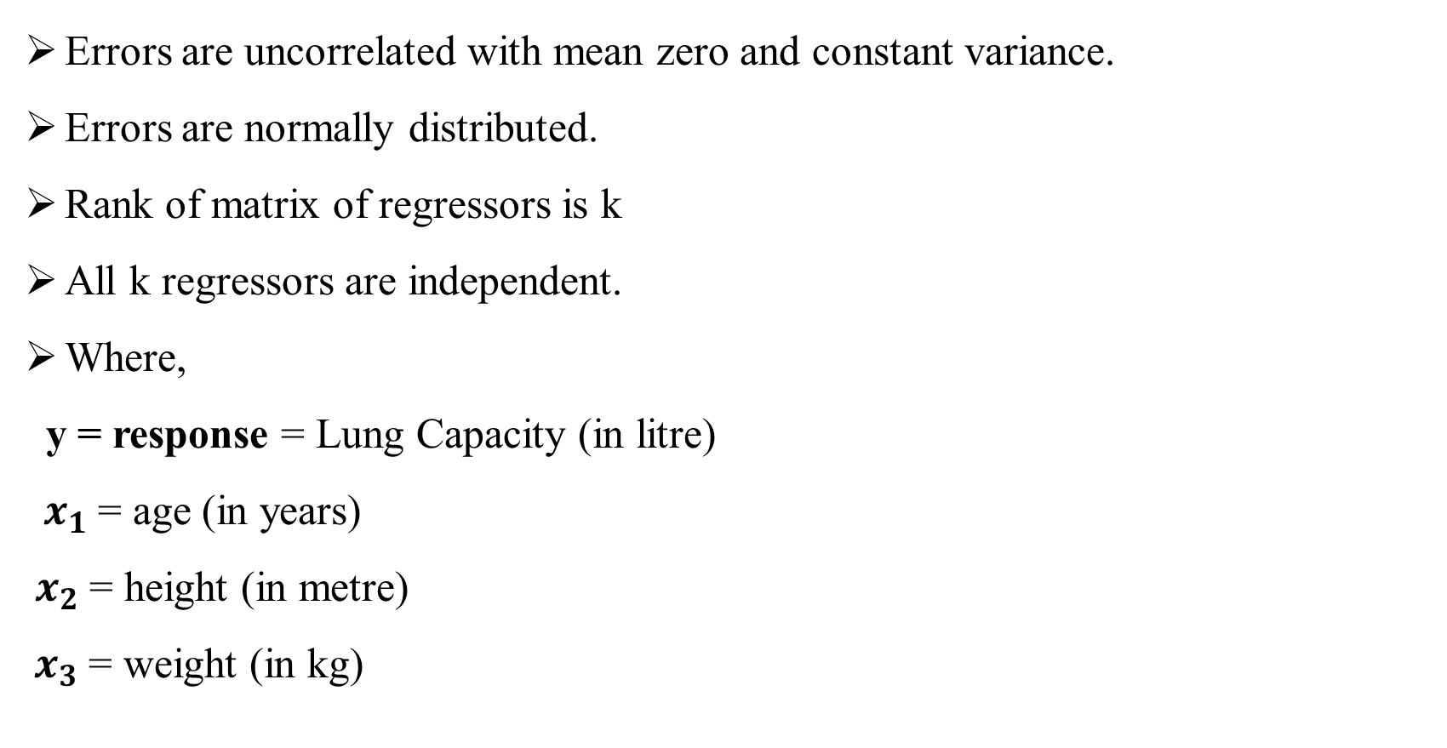
Multiple linear regression model
Assumptions:
Errors are uncorrelated with mean zero and constant variance.
Errors are normally distributed.
Rank of matrix of regressors is k
All k regressors are independent.
Where,
y = response = Lung Capacity (in litre)
${ x}_{1}$= age (in years)
$x_{2}$= height (in metre)
$x_{3}$= weight (in kg)

Slide 22
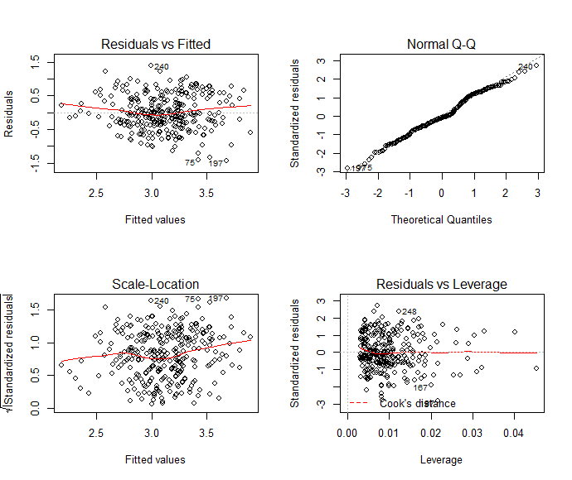
Diagnostic Analysis
Intercept is not significant and because of that the variability percentage explained by regressors is very low almost it is 23.7 % and thus we removed the intercept.
After removing intercept all regressors are significant with variability percentage explained by regressors is 97%.
Normality seems to be ok because most of the points are around the line.
Homoscedasticity assumption fails as it shows the double bow pattern.

Slide 23
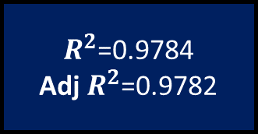

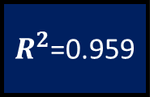
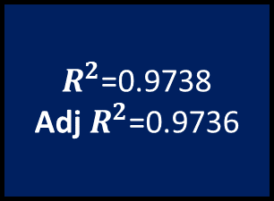
USED TRANSFORMATION FOR RESPONSE
Age
$R^{2}$=0.959
ln of Lung Capacity
$R^{2}$=0.9784
Adj $R^{2}$=0.9782
Height
Weight
Reciprocal of lung capacity
Age
Log of Lung
Capacity
$R^{2}$=0.9738
Adj $R^{2}$=0.9736
Height
Adj $R^{2}$=0.9586
Weight

Slide 24
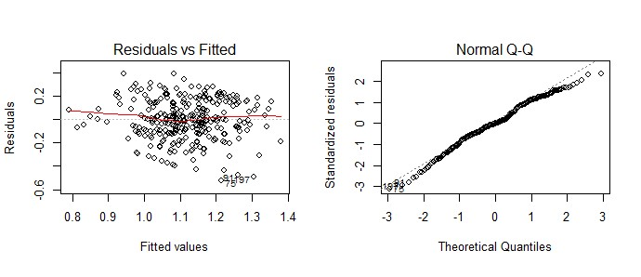
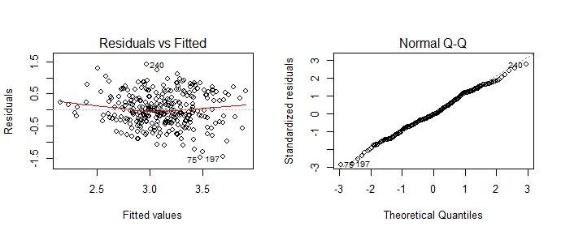
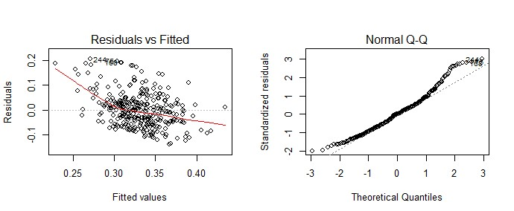
Diagnostic analysis of transformed model
ln (lung capacity)
Log (lung capacity)
Reciprocal of (lung capacity)

Slide 25
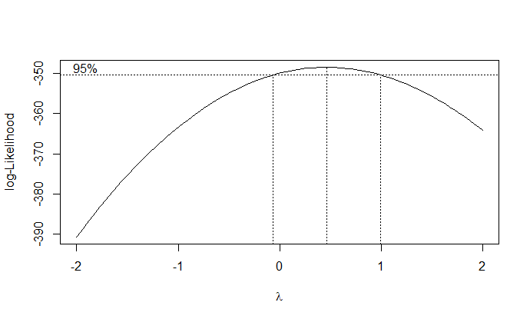
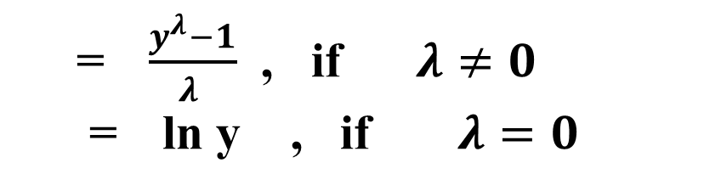
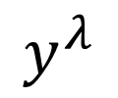
BOX – COX METHOD FOR TRANSFORMATION PURPOSE:
Formula:
=$\frac{y^{λ}−1}{λ }$ , if $λ≠0$
= ln y , if $λ=0$
$$y^{λ}$$
Multiple R squared= 0.9662
Adj R squared=0.9658
Regressors | Coefficients | P value
Age | -0.006319 | <2.89e-08
Height | 0.890802 | <2e-16
Weight | 0.004129 | <0.00407

Slide 26
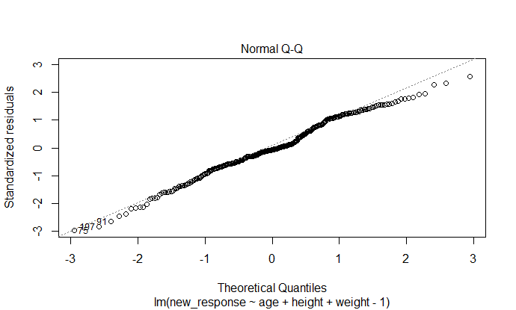
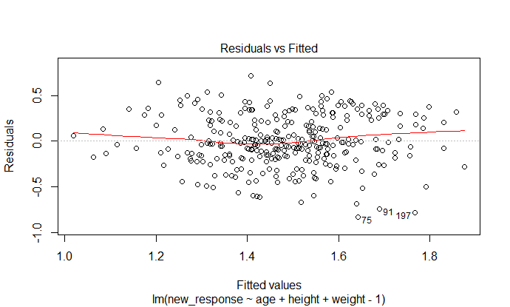
Normal Q-Q plot shows approximately normality.
Residual vs fitted plot shows double bow pattern hence, homoscedasticity assumption fails again for this model.

Slide 27
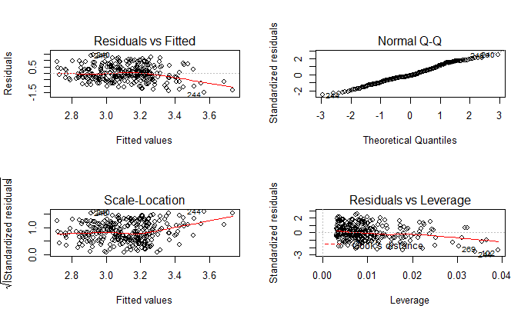
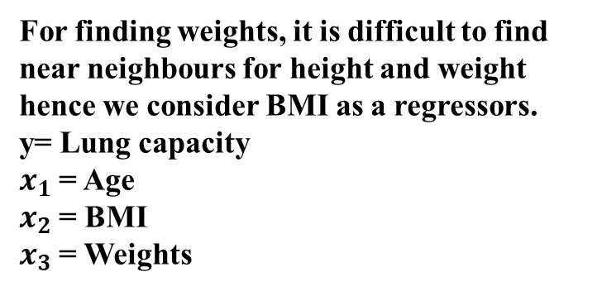
Weighted least square method for transformation
Reg | Estimates | P value
Age | -0.0132 | <9.49e-08
BMI | 0.0836 | < 2e-16
Weight | 4.7196 | < 2e-16
For finding weights, it is difficult to find near neighbours for height and weight hence we consider BMI as a regressors.
y= Lung capacity
$x_{1}$= Age
$x_{2}$= BMI
$x_{3}$= Weights
Multiple R squared= 0.9664
Adj R squared=0.966

Slide 28
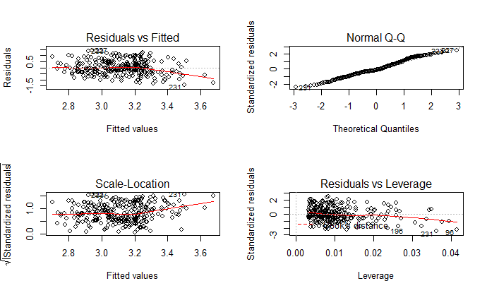
Regressors | Estimates
Age | -0.01336
BMI | 0.08112
Weights | 4.91129
Lung capacity= -0.01336*age + 0.08112*BMI +4.91129*weights
Note: The weights are obtained using weighted least square method.

Slide 29

Non Parametric Analysis
Kruskal – Wallis test
Mann Whitney test
Chi square of independence

Slide 30
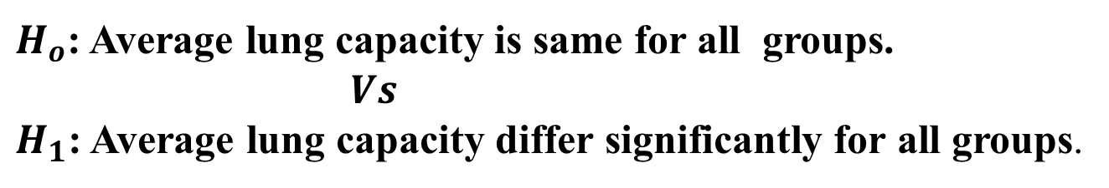
Kruskal Walli’s H test
For Age
For Weight
For Height
Statistic: 26.715
p value:
6.481e-05
Decision: lung capacity differ significantly for all age groups
Statistic: 52.767
p value: 0.014
Decision: lung capacity differ significantly for all weight groups
Statistic: 52.767
p value:
3.756e-10
Decision: lung capacity differ significantly for all height groups
$H_{o}$: Average lung capacity is same for all groups.
$Vs$
$H_{1}$: Average lung capacity differ significantly for all groups.

Slide 31
Kruskal Walli’s H test
For pulse rate
For Profession
Statistic: 0.93028
p value: 0.9202
Decision: lung capacity do not differ significantly for all pulse rate groups
Statistic: 19.604
Pvalue:0.00020
Decision: lung capacity differ significantly for all professions
For BMI
Statistic: 5.2223
p value: 0.2652
Decision: lung capacity do not differ significantly for all BMI groups

Slide 32
MANN WHITNEY TEST
Age
BMI
Profession

Slide 33
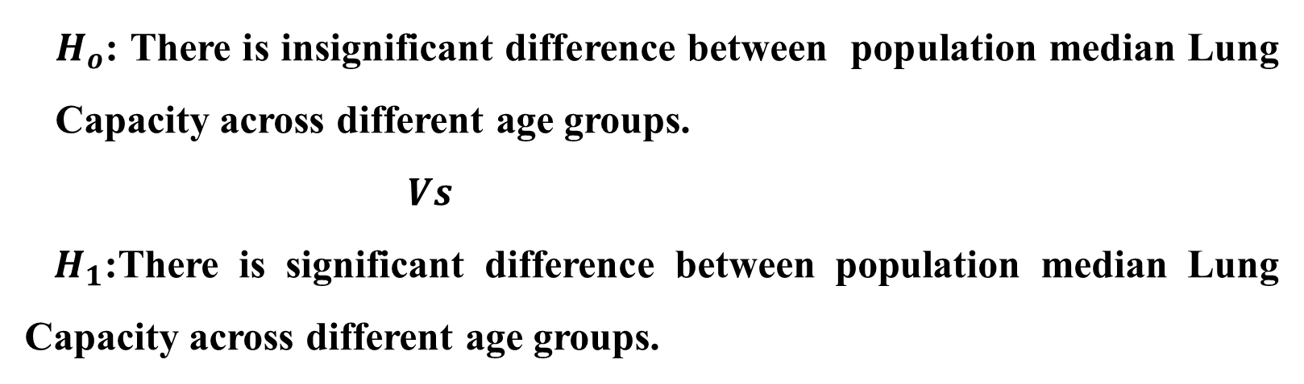
Age:
$H_{o}$: There is insignificant difference between population median Lung Capacity across different age groups.
$Vs$
${ H}_{1}$:There is significant difference between population median Lung Capacity across different age groups.
Name | Class limit
Age1 | 15-24
Age2 | 25-34
Age3 | 35-44
Age4 | 45-54
Age5 | 55-64
Age 6 | 65-74

Slide 34
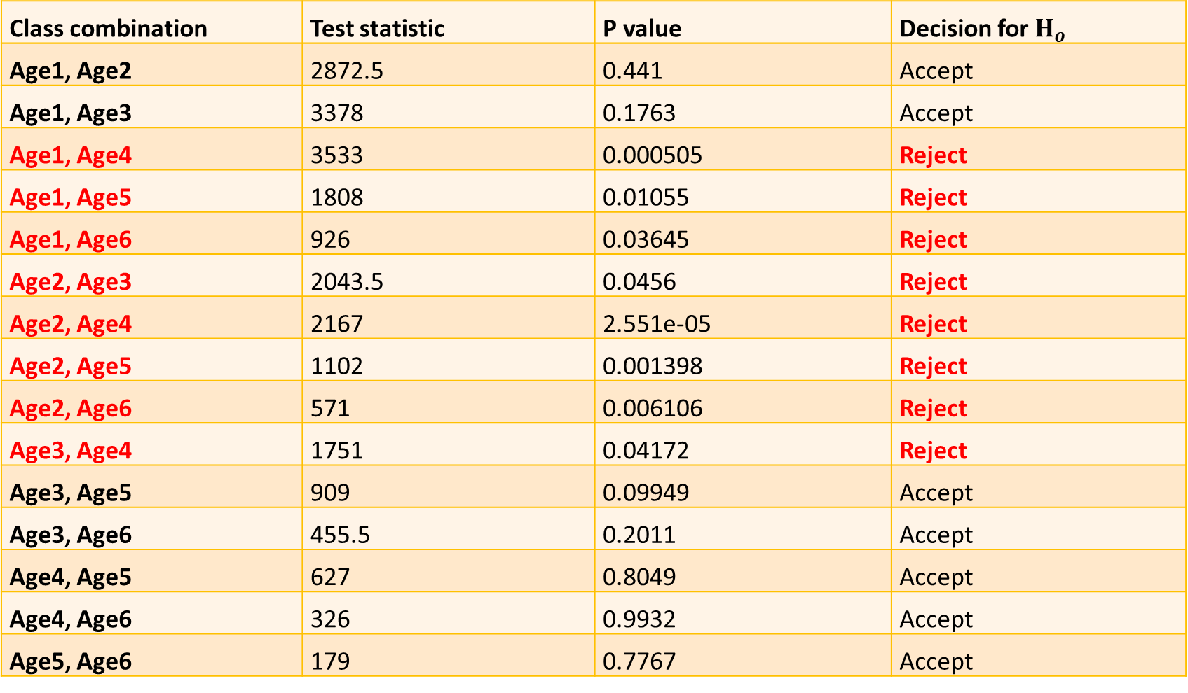
Class combination | Test statistic | P value | Decision for $H_{o}$
Age1, Age2 | 2872.5 | 0.441 | Accept
Age1, Age3 | 3378 | 0.1763 | Accept
Age1, Age4 | 3533 | 0.000505 | Reject
Age1, Age5 | 1808 | 0.01055 | Reject
Age1, Age6 | 926 | 0.03645 | Reject
Age2, Age3 | 2043.5 | 0.0456 | Reject
Age2, Age4 | 2167 | 2.551e-05 | Reject
Age2, Age5 | 1102 | 0.001398 | Reject
Age2, Age6 | 571 | 0.006106 | Reject
Age3, Age4 | 1751 | 0.04172 | Reject
Age3, Age5 | 909 | 0.09949 | Accept
Age3, Age6 | 455.5 | 0.2011 | Accept
Age4, Age5 | 627 | 0.8049 | Accept
Age4, Age6 | 326 | 0.9932 | Accept
Age5, Age6 | 179 | 0.7767 | Accept

Slide 35
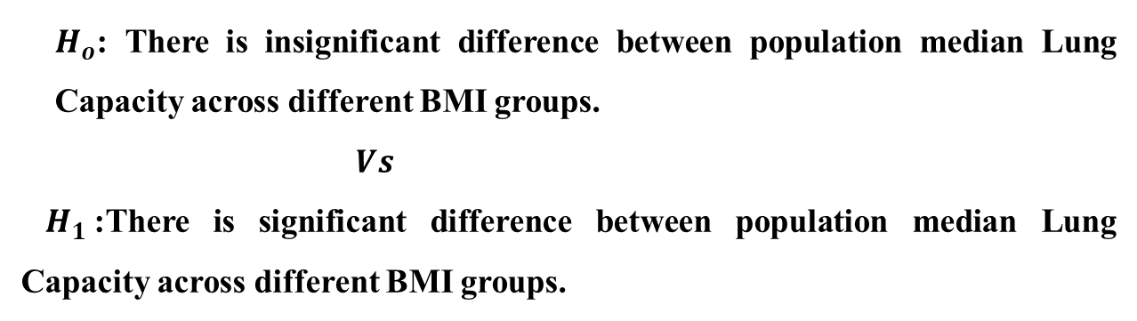
BMI
$H_{o}$: There is insignificant difference between population median Lung Capacity across different BMI groups.
$Vs$
${ H}_{1}$:There is significant difference between population median Lung Capacity across different BMI groups.
Name | Class limit
BMI1 | 14-19
BMI2 | 20-25
BMI3 | 26-31
BMI4 | 32-37
BMI5 | 38-43

Slide 36
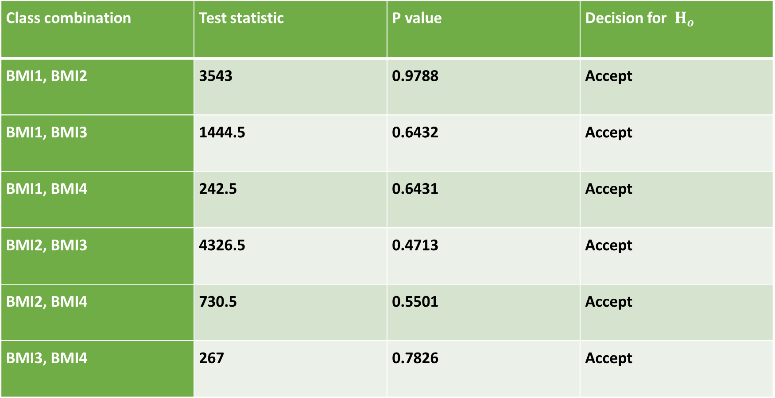
Class combination | Test statistic | P value | Decision for $H_{o}$
BMI1, BMI2 | 3543 | 0.9788 | Accept
BMI1, BMI3 | 1444.5 | 0.6432 | Accept
BMI1, BMI4 | 242.5 | 0.6431 | Accept
BMI2, BMI3 | 4326.5 | 0.4713 | Accept
BMI2, BMI4 | 730.5 | 0.5501 | Accept
BMI3, BMI4 | 267 | 0.7826 | Accept

Slide 37
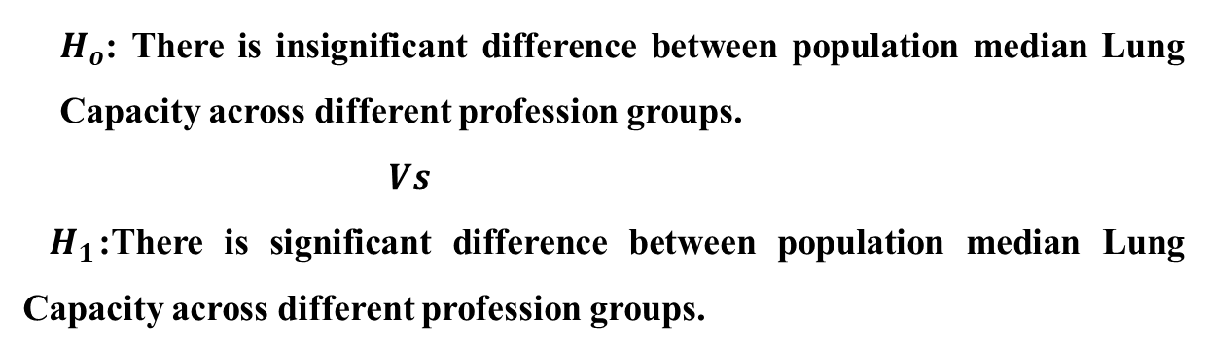
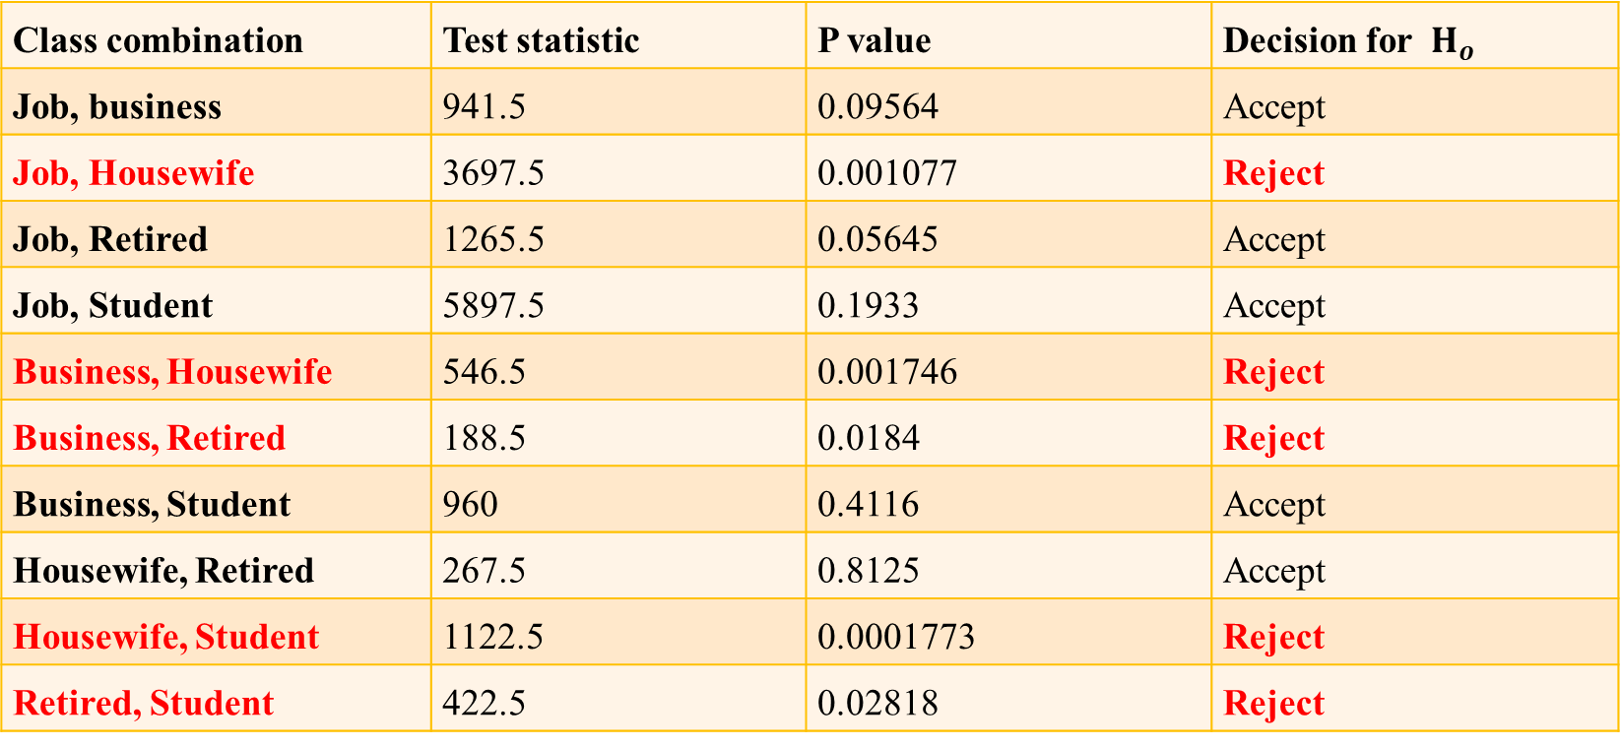
Profession:
$H_{o}$: There is insignificant difference between population median Lung Capacity across different profession groups.
$Vs$
${ H}_{1}$:There is significant difference between population median Lung Capacity across different profession groups.
Class combination | Test statistic | P value | Decision for $H_{o}$
Job, business | 941.5 | 0.09564 | Accept
Job, Housewife | 3697.5 | 0.001077 | Reject
Job, Retired | 1265.5 | 0.05645 | Accept
Job, Student | 5897.5 | 0.1933 | Accept
Business, Housewife | 546.5 | 0.001746 | Reject
Business, Retired | 188.5 | 0.0184 | Reject
Business, Student | 960 | 0.4116 | Accept
Housewife, Retired | 267.5 | 0.8125 | Accept
Housewife, Student | 1122.5 | 0.0001773 | Reject
Retired, Student | 422.5 | 0.02818 | Reject

Slide 38
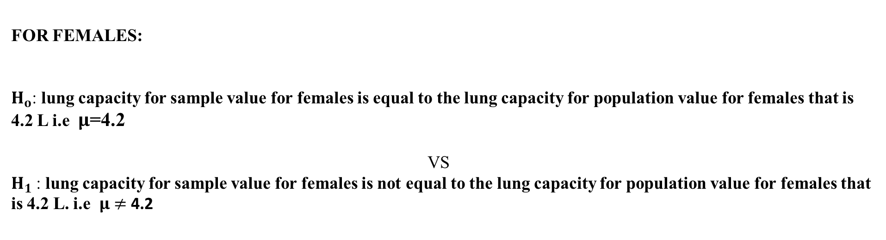
Verifying standard claim using sample data :
FOR FEMALES:
$H_{o}$: lung capacity for sample value for females is equal to the lung capacity for population value for females that is 4.2 L i.e $μ$=4.2
VS
$H_{1}$: lung capacity for sample value for females is not equal to the lung capacity for population value for females that is 4.2 L. i.e $μ$ $≠$ 4.2
Test statistic | P value | 95% CI | mean of sample
37.644 | <2.2e-16 | (2.78, 2.92) | 2.85
CONCLUSION: lung capacity for sample value for females is not equal to the lung capacity for population values for females.

Slide 39
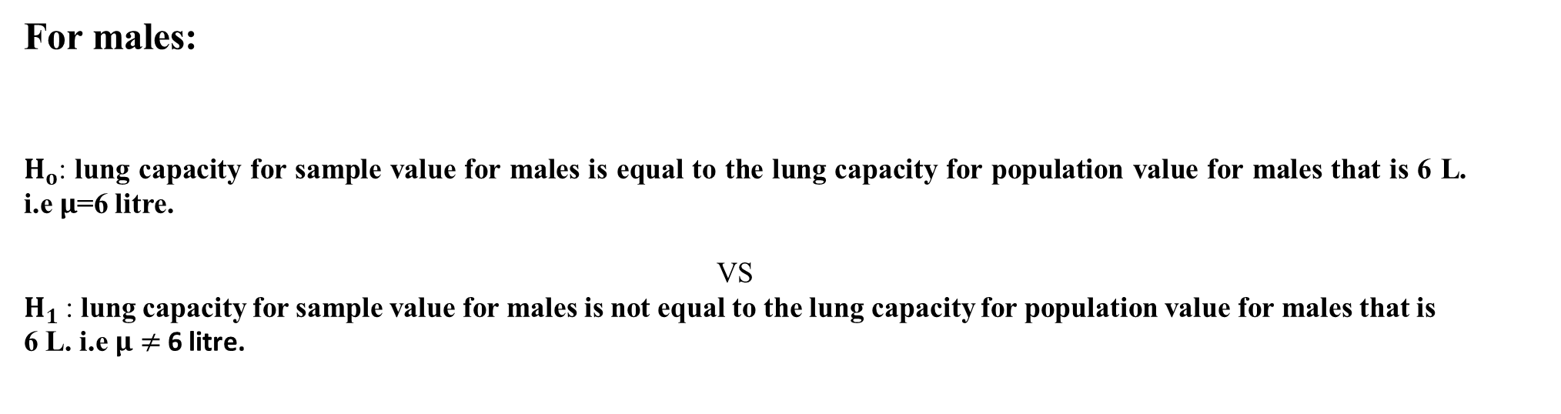
For males:
$H_{o}$: lung capacity for sample value for males is equal to the lung capacity for population value for males that is 6 L. i.e $μ$=6 litre.
VS
$H_{1}$: lung capacity for sample value for males is not equal to the lung capacity for population value for males that is 6 L. i.e $μ$ $≠$ 6 litre.
Test statistic | P value | 95% CI | mean of sample
55.434 | <2.2e-16 | (3.27, 3.46) | 3.36
CONCLUSION: lung capacity for sample value for males is not equal to the lung capacity for population values for males

Slide 40


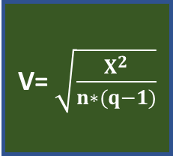
Independence of attributes
$χ^{2}$=7.5131
smoking
No association
P value: 0.4824
Lung capacity
Cramer’s V
Strong association
Test statistic: 0.1631742
V= $\sqrt{\frac{X^{2}}{n∗(q−1)}}$
$χ^{2}$=32.16
profession
Association
Pvalue:0.0095

Slide 41

CONCLUSIONS

Slide 42

Age, height, weight are linearly related with lung capacity.
Age is negatively correlated with lung capacity whereas height and weight are positively correlated with lung capacity.
The lung capacity is not normally distributed.
The best possible regression model for forecasting purpose is given as follows:
Lung capacity for sample data of females is 2.85L and for sample data of males is 3.36L
Average lung capacity is differing significantly for all age, height, weight, profession groups but does not differing significantly for pulse rate and BMI.
Lung capacity= -0.01336*age + 0.08112*BMI +4.91129*weights

Slide 43
For age all groups based on sample corresponding population median for lung capacity may be considered as unequal.
For all BMI based on samples, population median for lung capacity may be considered as equal.
There is no association between smoking and lung capacity.
There is a strong association between profession and lung capacity.
For profession, (job, housewife), (business, housewife),(business, retired),(housewife, student), (retired, student) have significantly different population median for lung capacity.

Slide 44
SCOPE:
The regression model obtained in this project can be used in medical field for obtaining the lung capacity of an individual by just substituting the values of his or her age, BMI and weights can be calculated as per the given formula without performing any experiment.
Water spirometer which is used in this project can be made easily by anyone and is cheapest among all measuring instruments which are used in the medical field. This type of procedure for estimating lung capacity is financially acceptable.

Slide 45
LIMITATIONS:
Observations of lung capacity do not follow Normal Distribution.
The experimental procedure is time consuming as we need approximately 7-8 minutes per observation.
Since some group of people did not understand the exact procedure of the experiment, they inhaled water from the pipe and further they did not co-operate with the procedure of the experiment.
Some individuals were not at rest before performing the experiment which might be affects their lung capacity value.
For information such as Age, Height, Weight, Profession we have to rely on the information provided by individuals.

Slide 46
References:
Tortora, Gerard J.(2016). Principles of anatomy and physiology. Derrickson, Bryan (15th ed.). Hoboken, NJ. Page number 874.
Introduction to Linear Regression Analysis. Douglas C. Montgomery, EA Peck, GG Vining (5th ed.).
https://www.researchgate.net/figure/nterpretation-of-Phi-and-Cramers-V_tbl2_326885374 (for Cramer’s V test)

Slide 47


Slide 48
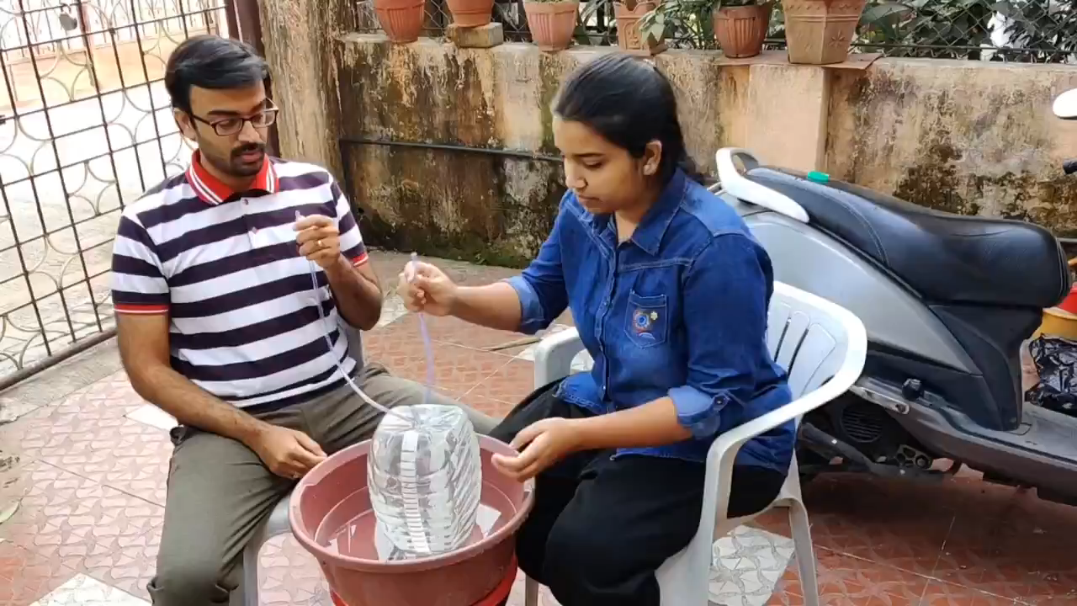
Data Collection Video

